Slide 1

Race to 100
Evan Brittain, Austin Smothers, Thien Nguyen

Slide 2

Welcome to race to 100
Rules:
Two players take turns to roll the die.
Be the first player to reach 100 points.
On a turn, each player rolls the die repeatedly until either:
A 1 is rolled
The player chooses to hold (if the player rolls a 2-6)

Slide 3
Scoring example
Example 1: Sherri rolls a 3 and decides to continue. She then chooses to roll seven more times (6, 6, 6, 4, 5, 6, 1). Because she rolled a 1, Sherri’s turn ends and she earns 0 points.
Example 2: The computer rolls a 6 and decides to continue. It then chooses to roll four more times (3, 4, 2, 6) and decides to hold. The computer earns 21 points for this turn (6 + 3 + 4 + 2 + 6 = 21).

Slide 4
Objective
Create a program where the user can play Race to 100 against an AI which will prove to be a challenging opponent.
The program should be user friendly, allowing a first time player to understand the mechanics of the game with minimal difficulty.
The AI should follow a set of rules which govern its behavior with no bugs nor errors.
The program should have a sufficiently pseudorandom function to produce dice rolls.

Slide 5
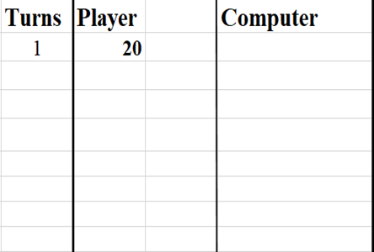
Strategy to win
Strategy 1: Hold once you reach 20 points

Slide 6
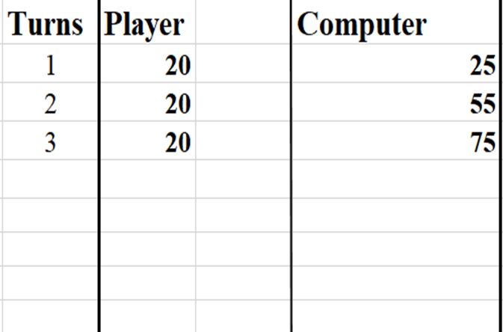
Strategy 2: Consider the other player’s score

Slide 7
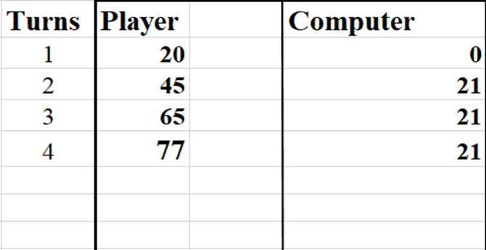
Strategy 3: Can I win this turn?

Slide 8
Code Structure
Code is separated in two main loops (Computer/Player)
Each loop contains various comparison statements that determine:
If player wants to continue rolling or deposit
If player/computer rolled a 1
If computer has accumulated enough points to end turn
If player/computer has accumulated enough points to win
Program jumps between each loop until player/computer has totaled 100 points. It then jumps to the appropriate output statement

Slide 9
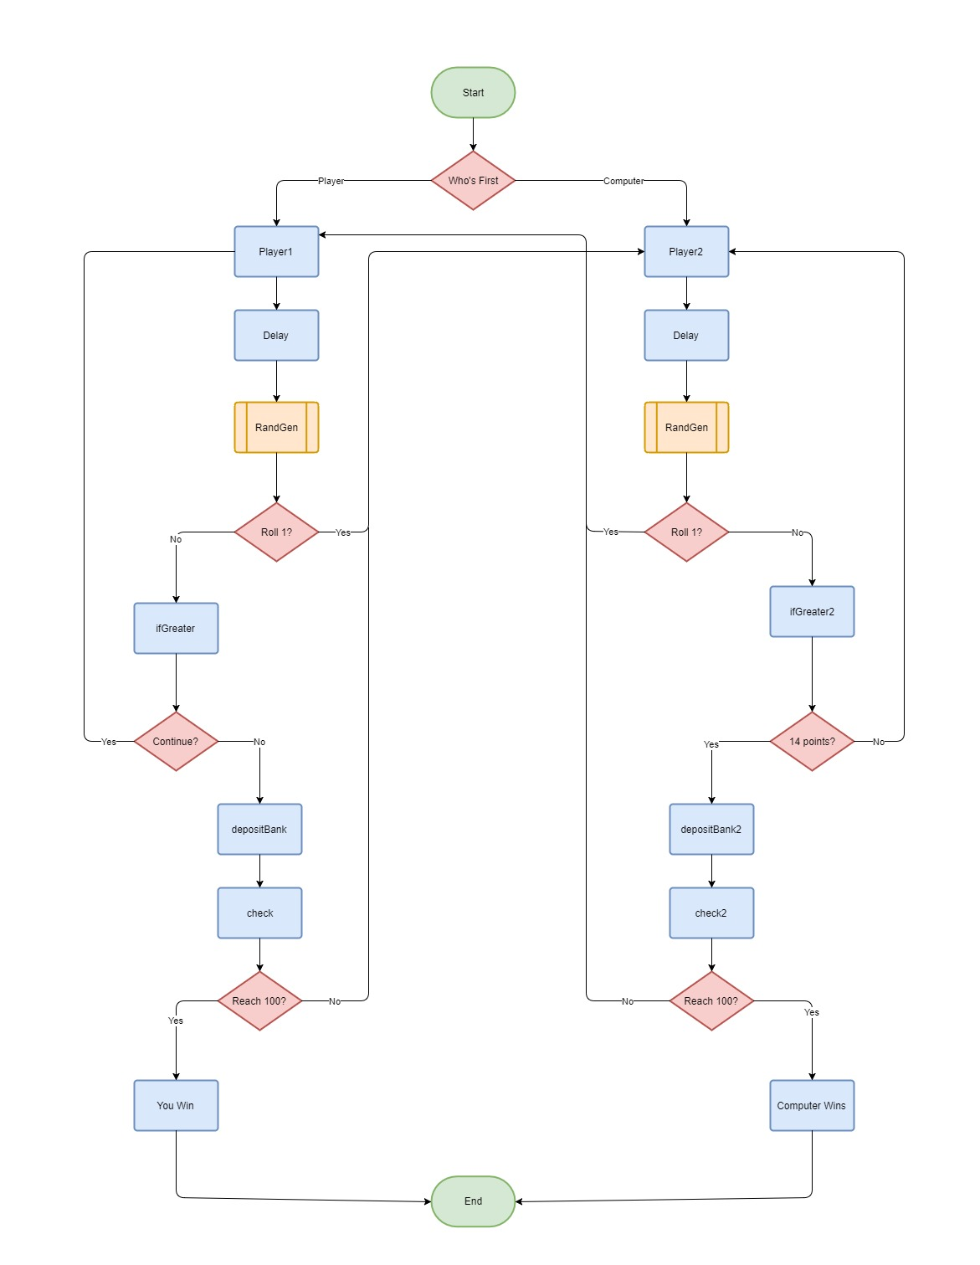

Slide 10
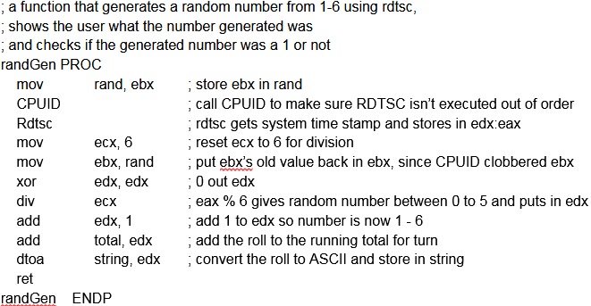
RDTSC as a Random Number Generator
Reads the system clock and stores in EDX:EAX
EAX stores the low bits of the system clock
Time of play and time elapsed between user inputs are unknown, so we can use RDTSC as a pseudo-random number generator

Slide 11
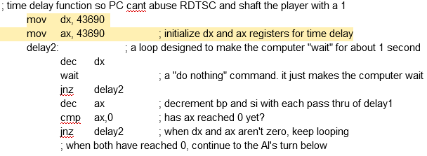
Time Delay Function
makes the processor wait for ~ 87,000 core cycles (roughly 1 second)
Need for this is because modern processors are so fast that they could generate the same “random” number thousands of times in a single system clock tick.

Slide 12
Quick Maths
Race To 100’s AI was designed using a mixture of calculus and statistics to determine when it should bank its points, and when it should roll again
What does a statistically average turn look like? Let n = number of rolls
A “Scoring Roll” will have a point value ranging from 2-6, with each value being equally likely. This means the average points earned per roll is 4, and the equation for average points scored per turn is 4*n
The likelihood of rolling consecutive “Scoring Rolls” is (⅚)^{n}
This means the points earned per turn and the likelihood of not rolling a 1 can be governed by the equation: (avg pts/turn) = 4n * (⅚)^{n}
Deriving this, we find that an “optimal” turn takes ~5.5 rolls

Slide 13
Quick Maths cont...
We can’t make 5.5 rolls in a turn, so we must examine the two neighboring numbers, 5 & 6, and find which is more optimal if we wish to use number of rolls as a variable to control the AI’s decisions.
Going back to our equation: 4n*(⅚)^{n}, we find that 5 nets ~8.03 pts per turn, and 6 nets ~ 8.03 pts per turn. 5 is preferred because 1’s are less likely
If we reach further, we find that 4 nets ~7.7 pts per turn, and that all three of these pt per turn values finish the game in an average of 13 turns, so 4 is the optimal number of rolls per turn, as it leaves you least likely to roll 1’s
Plugging our points equation into a graphing calculator with n = 4 rolls reveals an average of 14 pts earned/turn as normal, with a standard deviation in points of +/- 3 points as statistically normal
Different from the 7.7 pts/turn, as this analysis treats scoring 0’s as outliers

Slide 14
When to Hold ‘Em
Our AI must check if it has accumulated enough points to win after every roll
Our AI plays riskier if either itself or the player is within 17 points of 100, as this would make them statistically likely to win in one turn
Our AI plays riskier if the player is significantly ahead of the AI in points (14+ points ahead)
Our AI checks if it has scored 14 or more points in one turn. If it has, it holds, as it has had a statistically acceptable turn
Our AI checks if it has rolled more than 4 times in a turn. If it has, it holds, as it is likely still within the std. dev of a “normal” turn, and rolling again isn't worth risking the turn’s accumulated points
If none of these are met, the AI rolls again, as it has had a suboptimal turn

Slide 15
Were we successful in developing Race to 100?
Let’s find out as a class. We as a collective will play a game of Race to 100 against the AI.
If the program fails to perform exactly as outlined in this presentation, we will have failed.
Whether the AI or the class wins, if the program runs to completion as outlined, we will have succeeded.

